Slide 1
QAlasers_Precision Unified Automation Framework
UI + API (Hybrid) · Selenium · Rest Assured · Cucumber · TestNG · Maven
Application Under Test: automationexercise.com
Submitted To: Veeva Systems

Slide 2
Introduction
The Precision Unified Automation Framework is a Hybrid Test Automation Framework developed for automating both UI Testing and API Testing of the AutomationExercise web application (https://automationexercise.com). It follows a Maven multi-module architecture with separate modules for UIAutomation, APIAutomation, and Common utilities to ensure maintainability, scalability, and reusability.
The framework uses BDD (Behavior Driven Development) with Cucumber and TestNG, allowing test scenarios to be written in simple Gherkin language understandable by both technical and non-technical stakeholders. It integrates Selenium WebDriver for UI testing along with Page Object Model (POM) and RestAssured for API validation with a Layered API Design (Client → Request Builder → Validator) for clean and structured automation.

Slide 3
Requirements Analysis
Objective
Build a Precision Unified Automation Framework for UI + API testing of automationexercise.com
Key Requirements
Application Under Test: AutomationExercise.com (Web Application)
Automation Scope
Hybrid testing: UI + API integration
UI: End-to-end journeys, cross-browser
API: RESTful (GET, POST, PUT, DELETE), schema & negative testing
Framework Architecture
Maven multi-module (UIAutomation, APIAutomation, Common)
Externalized config & test data (no hardcoding)
Layered API design: Client → Request Builder → Validator
Scalable, maintainable, reusable components
Technology Stack
UI: Selenium WebDriver + Cucumber + TestNG + POM
API: RestAssured + Cucumber + TestNG + JSON Schema Validation
Build: Maven with parallel execution

Slide 4
Design Patterns & Strategies
Wait strategies: explicit, fluent, custom utilities
Factory pattern: driver & test data factories
Builder pattern: API request builders
Thread safety: TestContext for parallel runs
Robust error handling
Reporting & Execution
ExtentReports + Allure
Log4j2 logging, screenshots for UI failures
3-thread parallel execution
Data Management
UI: Excel-driven test data
API: POJOs + Data Factories
Shared: Externalized configuration

Slide 5
Objectives
The key objectives of this project are:
Design Hybrid Automation Project (UI+API) within a single unified framework.
Implement a multi-module Maven architecture
Page Object Model (POM)
Implement Layered API design (Client -> Request Builder -> Validator)
Parallel Test Execution
Logging and Reporting

Slide 6
Test Coverage
The framework includes comprehensive testing of both UI and API functionalities to ensure complete validation of the AutomationExercise application.
UI Testing
➢ Registration
• TC1 – User Registration
➢ Login
• TC2 – Valid User Login
• TC3 – Invalid User Login
➢ Cart
• TC4 – Add Product to Cart
• TC5 – Remove Product from Cart

Slide 7
API Testing
➢ Product APIs
• TC1 – Get All Products
• TC2 – Search Product
➢ User APIs
• TC3 – Create User Account
• TC4 – Delete User Account
• TC5 – Update User Account
• TC6 – Negative Validation

Slide 8
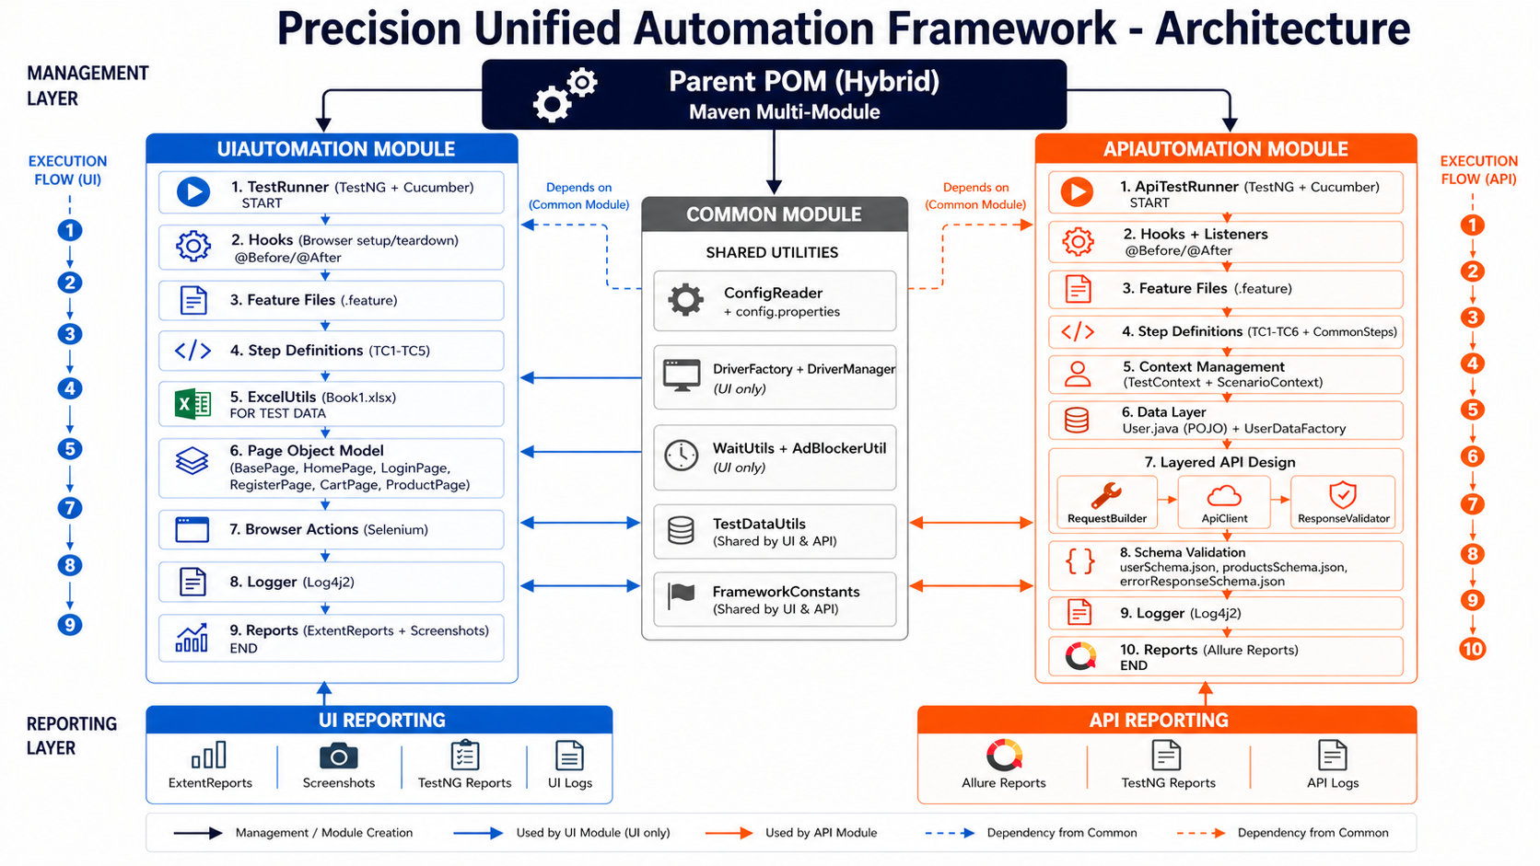

Slide 9
Project Workflow
Overall Framework Execution
Parent POM → UI Module → API Module
UI Automation Workflow
TestRunner → Hooks → Feature Files → Step Definitions (3 threads parallel) → ExcelUtils → Page Objects → Browser Actions → ExtentReports + Logs
API Automation Workflow
ApiTestRunner → Hooks → Feature Files → Step Definitions (3 threads parallel) → TestContext → Data Layer → API Layers → Schema Validation → Allure Reports + Logs
Shared Dependencies
Common Module → ConfigReader, DriverFactory , WaitUtils , Logger, FrameworkConstants, config file

Slide 10
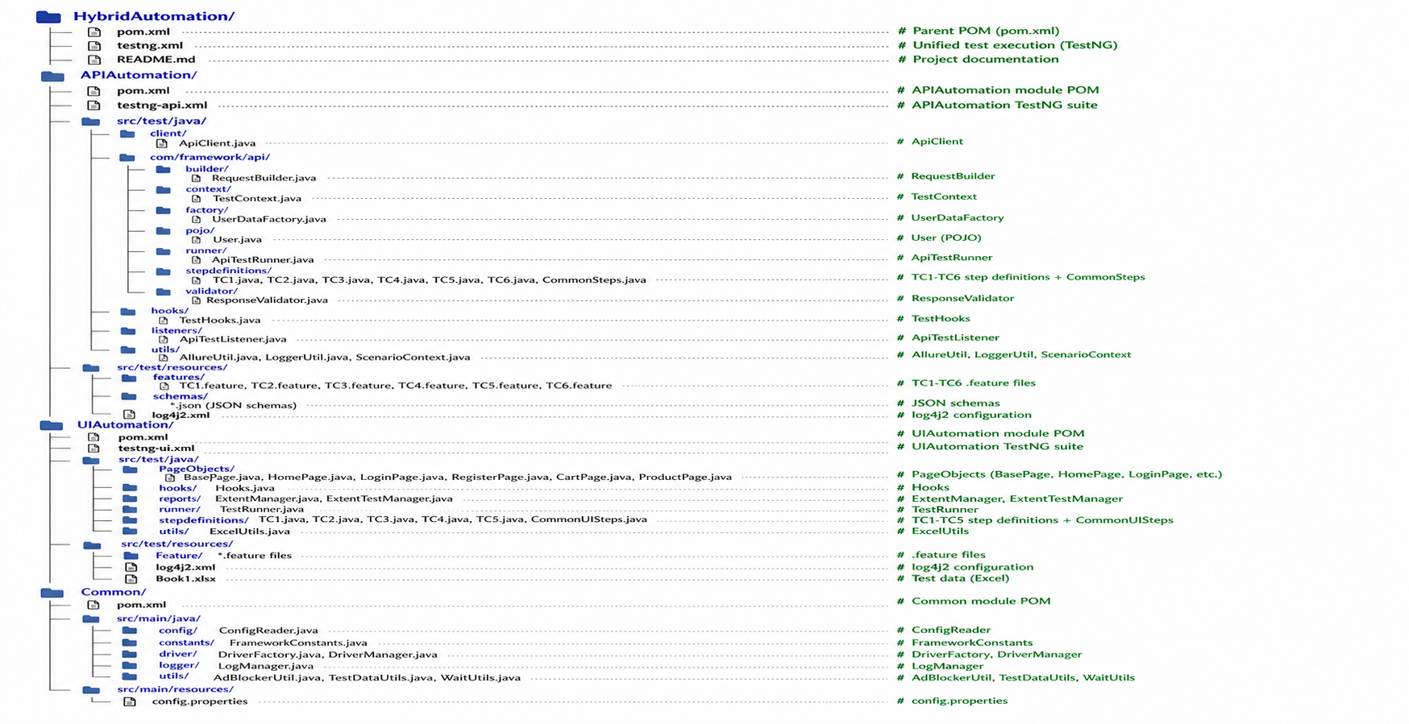
Framework Directory Structure

Slide 11
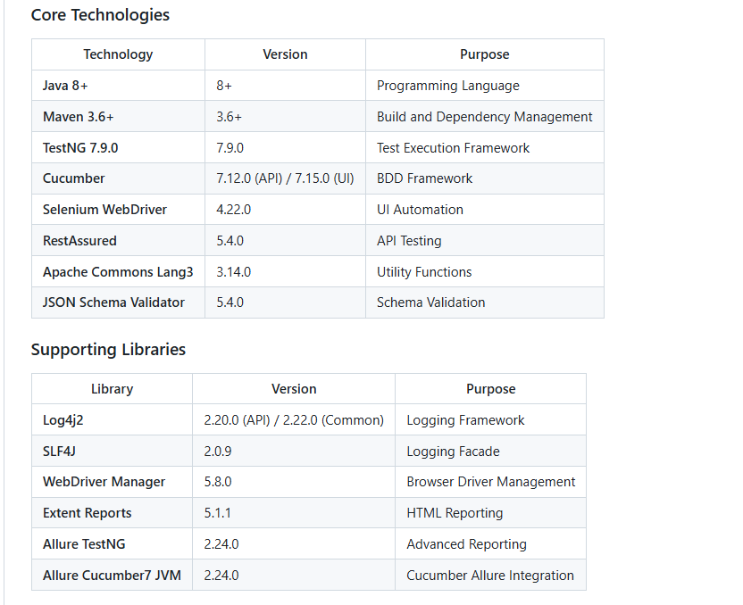
Tech Stack

Slide 12
Code Implementation
1) API Automation Module
ApiClient.java – Sends GET, POST, PUT, and DELETE requests for API endpoints.
RequestBuilder.java – Builds headers, parameters, authentication, and request body.
TestContext.java - Thread-safe test data sharing
UserDataFactory.java – Generates dynamic test data like username, email, and password.
User.java – POJO class used for JSON request and response mapping.
ApiTestRunner.java – Executes API test cases using Cucumber and TestNG.
stepdefinitions – Maps API feature steps to Java implementation.
ResponseValidator.java – Validates status code, response body, and JSON schema.
TestHooks.java – Handles cucumber lifecycle management.
ApiTestListener.java - TestNG execution monitoring with enhanced failure reporting, stack traces etc.,
AllureUtil.java - API request/response attachment to Allure
LoggerUtil.java - Structured logging framework
ScenarioContext.java - ThreadLocal scenario data management
features – Stores API feature files written in Gherkin format.
schemas – Contains JSON schema validation files.
log4j2.xml – Logging configuration
testng-api.xml – Executes API test suites separately.

Slide 13
2) UI Automation Module
PageObjects – Contains page classes with locators and reusable actions.
Hooks.java – Handles browser launch, close, and screenshot capture on failure.
TestRunner.java – Executes UI test cases using Cucumber and TestNG.
ExtentManager.java – Configures ExtentReports with SparkReporter, generates timestamped reports, and sets system info.
ExtentTestManager.java - Manages thread‑safe ExtentTest instances with lifecycle methods, enabling parallel execution.
stepdefinitions – Maps UI feature steps to Java test method implementations.
ExcelUtils.java – Reads test data from Excel files for Data-Driven Testing.
Feature – Stores UI test scenarios written in Gherkin format.
testng-ui.xml – Executes UI test suites separately.
3) Common Module
ConfigReader.java – Reads values from configuration file.
DriverFactory.java – Initializes browser drivers for execution.
DriverManager.java – Manages ThreadLocal WebDriver for parallel execution.
LogManager.java – Maintains execution logs for debugging.
WaitUtils.java – Handles explicit waits and synchronization.
config.properties – stores both UI and API tests configurations.
4) Root Files
pom.xml – Parent Maven file used for dependency management.
testng.xml – Executes both UI and API tests together.
README.md – Contains project setup and execution instructions.

Slide 14
Execution Steps
Step 1 – Run mvn clean to remove previous build files.
Step 2 – Run mvn install to download dependencies, compile the code, and build the project.
Step 3 – Run mvn test to execute all test cases (UI+API) or Right-click pom.xml and select Run As → Maven test to execute both UI and API tests.
Step 4 – cd APIAutomation and Run mvn allure:serve to generate and view the Allure Report in live on Browser.
Step 5 – After execution, the framework automatically generates Extent Reports, Allure Reports, TestNG Reports, Cucumber Reports, screenshots for failed UI tests, and execution logs for debugging and validation.
Note:
– Right-click TestRunner.java or testng-ui.xml and select Run As → TestNG Suite to execute UI test cases only.
– Right-click ApiTestRunner.java or testng-api.xml and select Run As → TestNG Suite to execute API test cases only.

Slide 15
Execution Reports
After test execution, the framework automatically generates reports for both UI and API automation.
TestNG Reports
Shows total executed tests, pass/fail/skip count, execution time, and suite summary.
Cucumber Reports
Shows feature-wise execution, scenario status, and step-by-step Given–When–Then details.
Extent Reports (UI)
Shows UI execution status, timeline, step logs, and embedded failure screenshots.
Location: UIAutomation/reports/<ExtentReport>.html
Allure Reports (API )
Generate and open the interactive Allure report using: mvn allure:serve inside APIAutomation module.
Provides step-by-step execution details, pass/fail status, request-response validation, execution timeline, and debugging logs.
Location: APIAutomation/allure-results/
Failure Reports
UI failures automatically capture screenshots, and API failures store request-response logs for quick debugging and issue resolution.

Slide 16
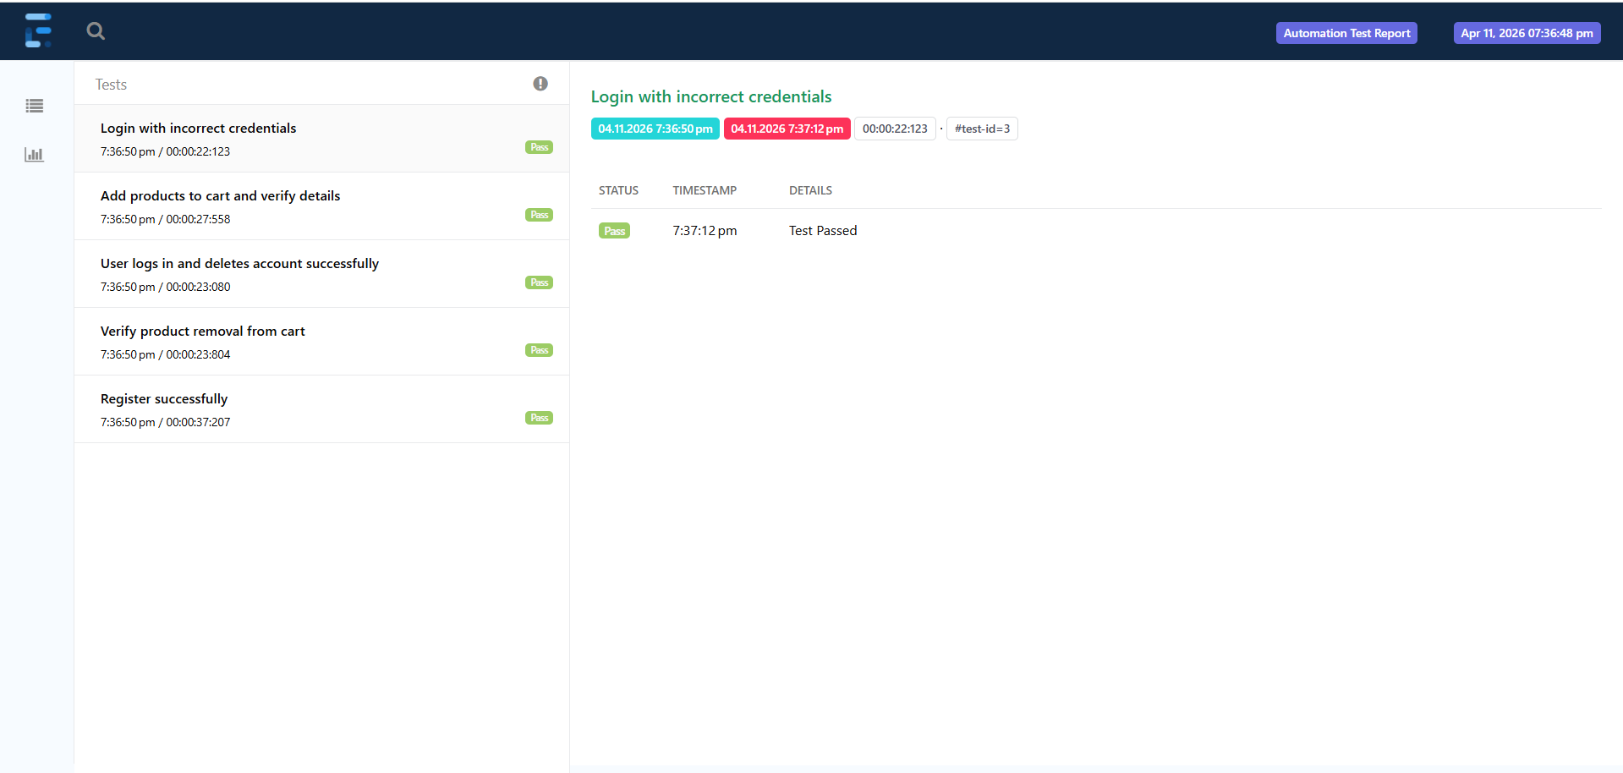
Extent Reports for UI Automation Tests
When all tests are passed:

Slide 17
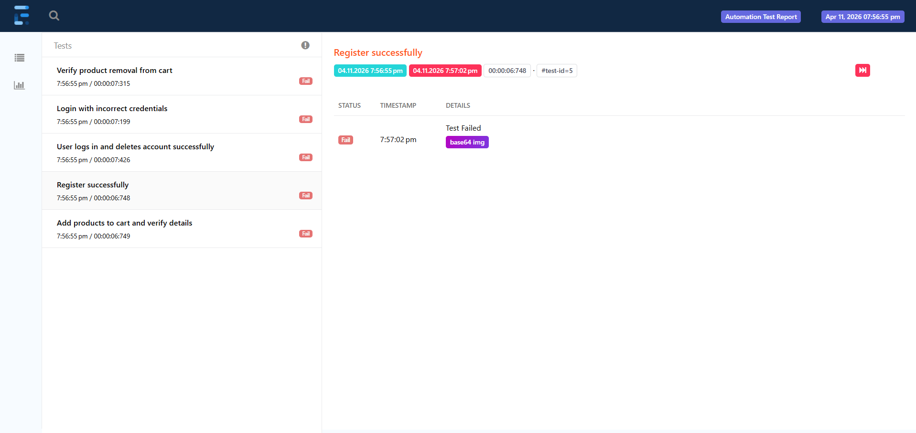
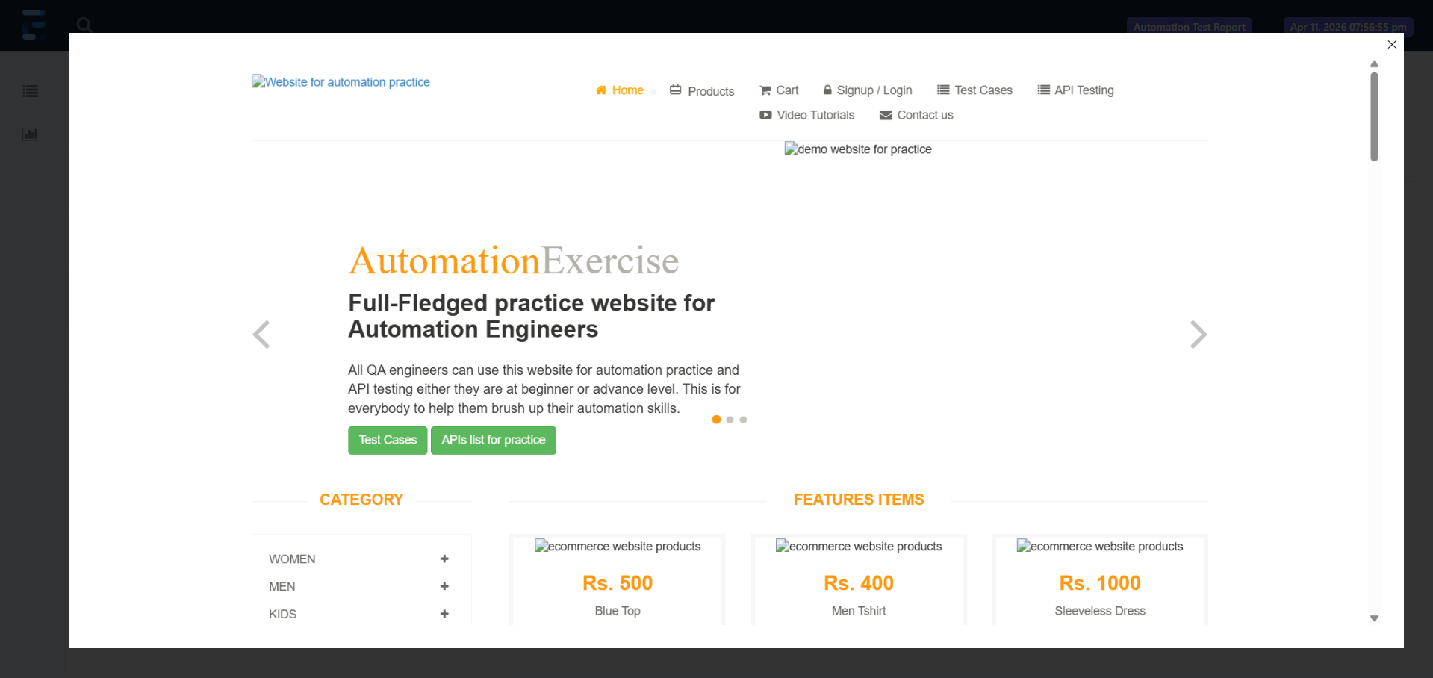
Extent Reports for UI Automation Tests
When test is failed:

Slide 18
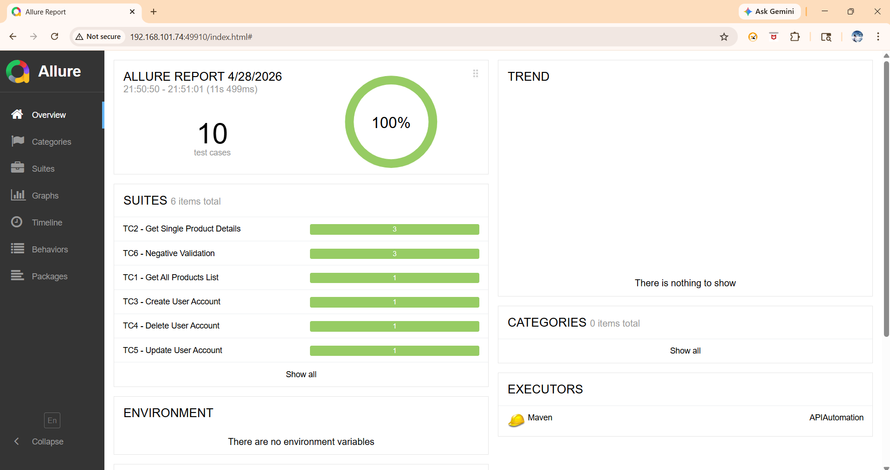
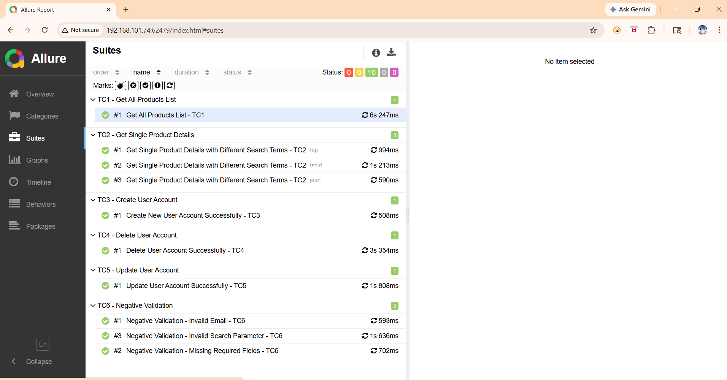
Allure Reports for API Automation Tests
When all tests are passed:

Slide 19
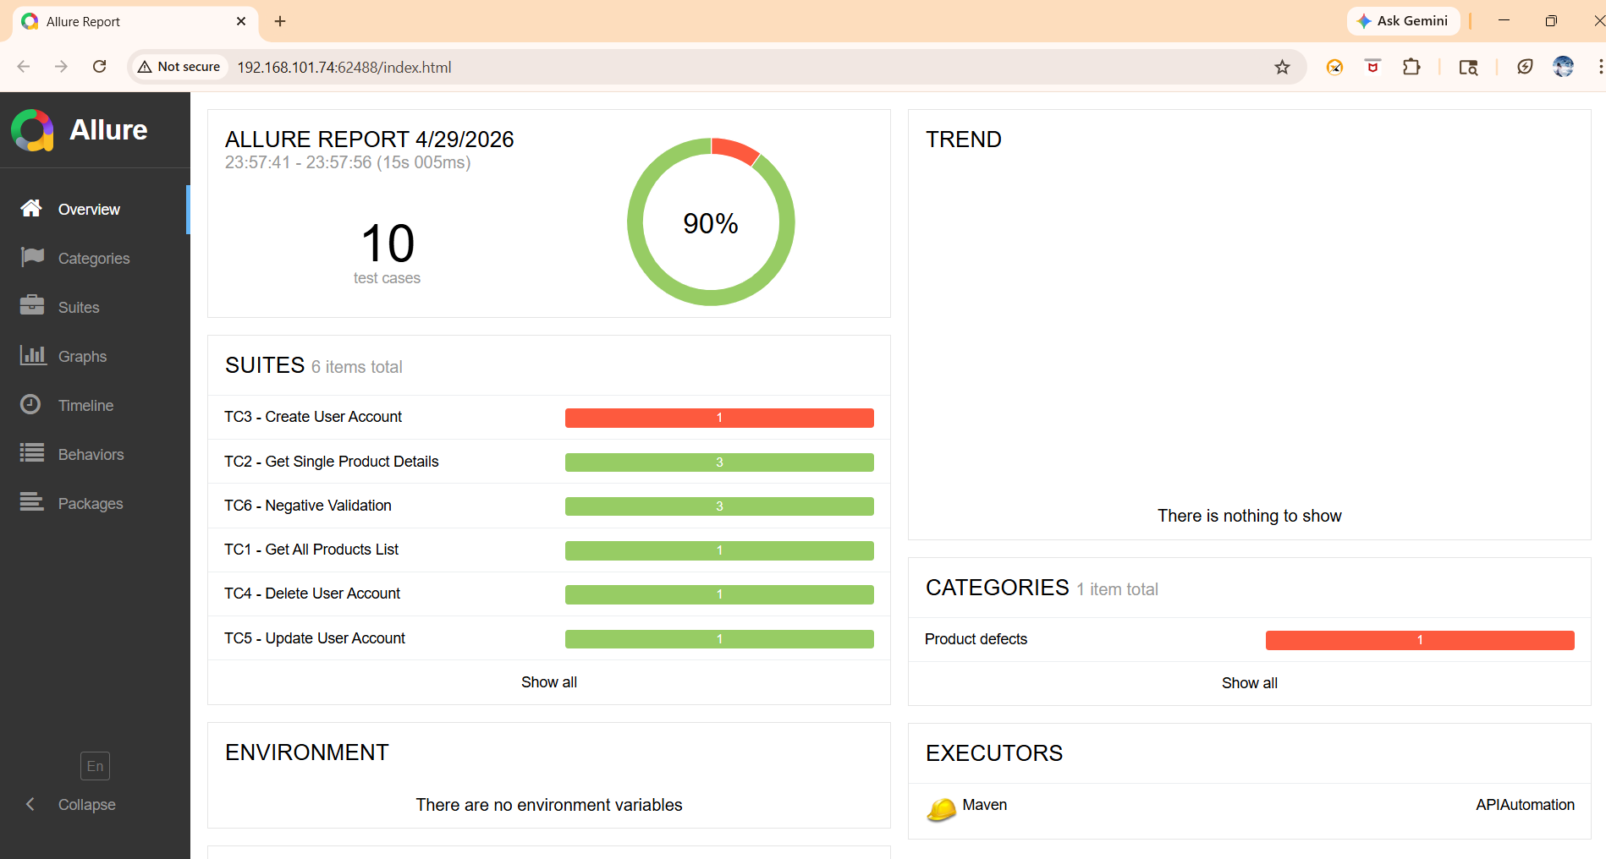
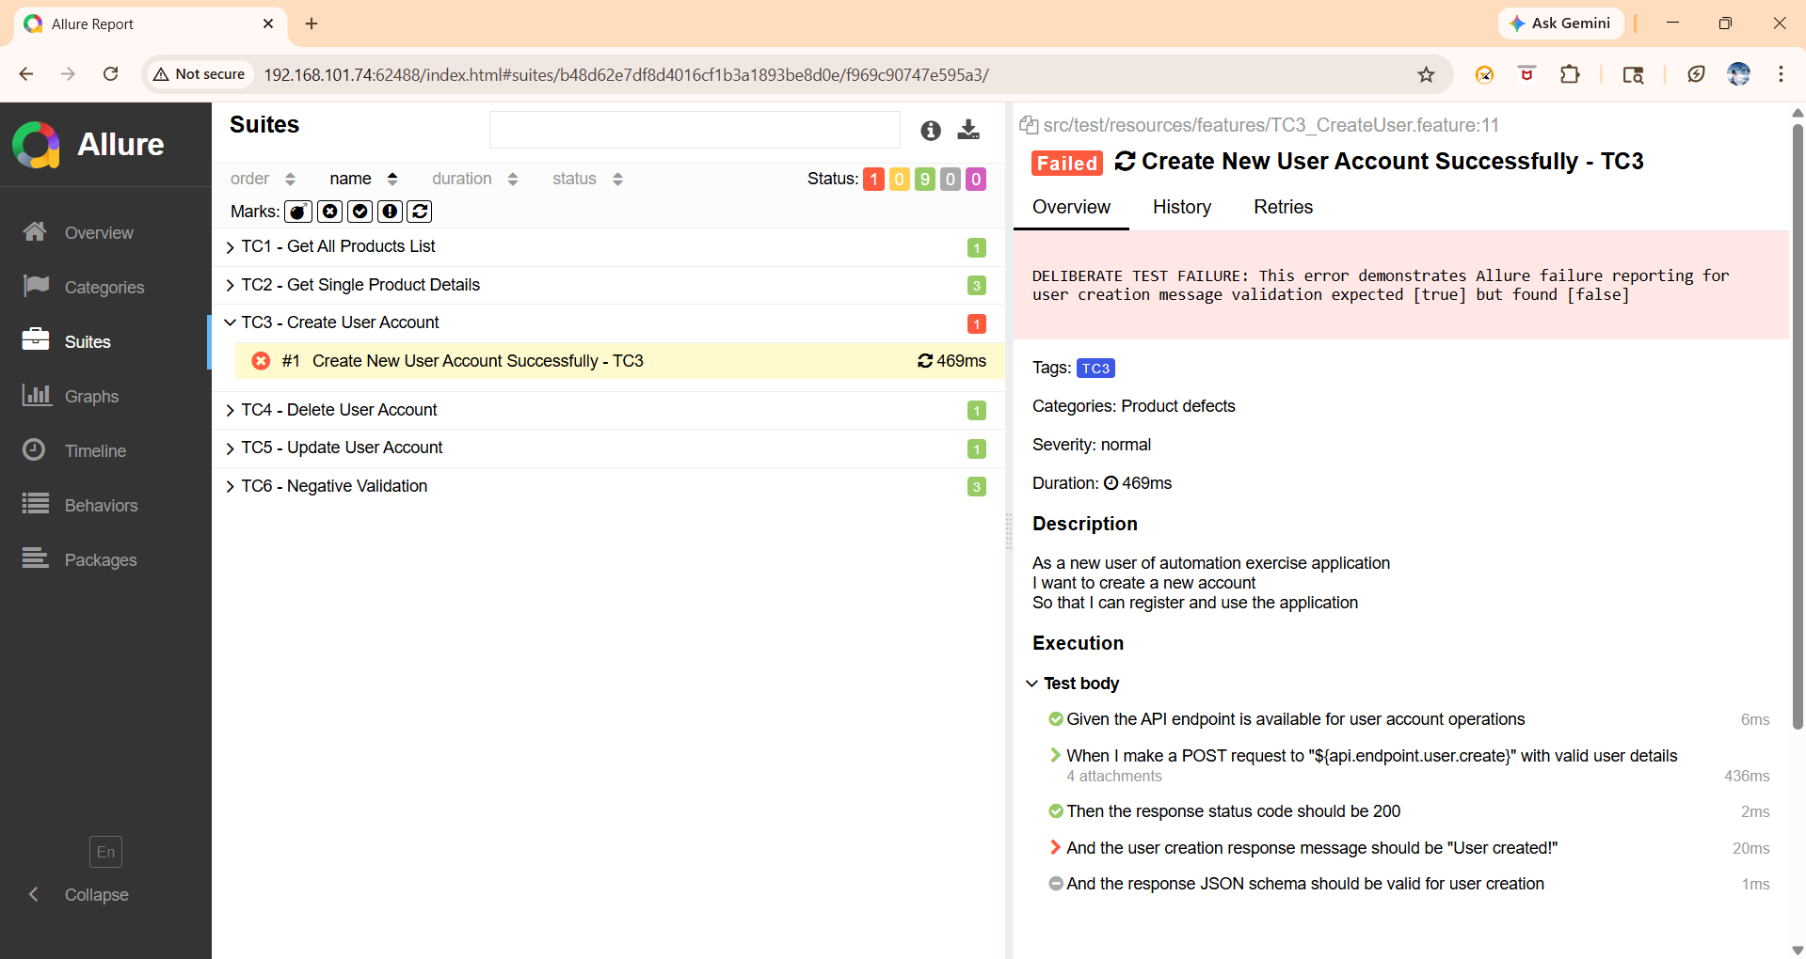
Allure Reports for API Automation Tests
When test is failed:

Slide 20
Conclusion
The Precision Unified Automation Framework delivers enterprise-grade hybrid testing with a scalable Maven multi-module design.
Key Highlights:
Unified UI (Selenium) + API (RestAssured) automation
Modular separation: UIAutomation, APIAutomation, Common
BDD with Cucumber + TestNG
Parallel execution within the modules.
Advanced reporting: ExtentReports & Allure
Robust API validation via JSON schema
Design patterns: POM, Builder, Factory
Data-driven: Excel (UI) & POJO (API)
Thread-safe execution with TestContext
Production-ready logging & error handling

